Slide 1
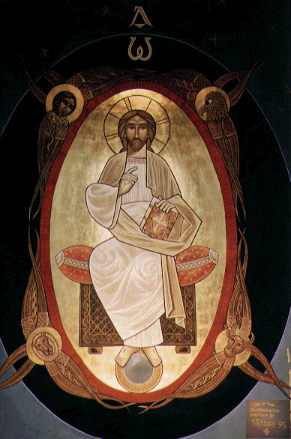
Of All Nations

Slide 2
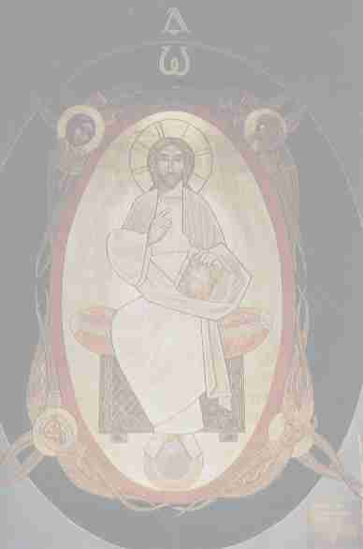
Of All Nations
Of All Nations
Of all nations...of all tribes...of all people Of all nations...of all tribes...of all tongues
Before the throne stand...myriads of myriads (2) Coming from everywhere (2)

Slide 3
Of All Nations
Of All Nations
1-Before judges they stand in chains they tied their hands In justice they bore to with their eyes highly aimed
They were the ones he saved...with the blood he gave (2)
...I saw them thanking as they made their way
Of all nations...of all tribes...of all people Of all nations...of all tribes...of all tongues
Before the throne stand...myriads of myriads (2) Coming from everywhere (2)

Slide 4
Of All Nations
Of All Nations
2-In the furnace they stroll in prison as if at home In the spirit they felt consoled in Christ they were absorbed
They were the ones he saved...with the blood he gave (2)
...I saw them cheering as they made their way
Of all nations...of all tribes...of all people Of all nations...of all tribes...of all tongues
Before the throne stand...myriads of myriads (2) Coming from everywhere (2)

